Slide 1
Using Web Services
IN721 2017
Design and Development for Mobile Devices
Session 9.1
Notes:
When you’re working in Android, you have access to the web
Users will have wireless, or cell access that lets you programatically launch a URL just as though you were typing it into the browser
We have, in fact, already seen that we can use an intent to open a browser on the phone to a specific web site.
More usefully, though, there are 1000s of web sites that provide services of some kind, usually data.
We can send a URL from an Activity to one of these sites and it will return text data that we can then use in our apps.
Sites that provide this kind of service have syntactic rules about the URLs they can receive.
These rules constitute their API. APIs can range from very simple (Eventful) to hideously complex (facebook).
Today we are going to talk about what those URLs look like and how to access them from your Android code.
Then in practical, you will have a chance to explore some useful services.

Slide 2

Fetching Data
Notes:
You will be familiar with URLs of this format: some sort of path, followed by ?, followed by one or more key=value pairs
This is a query string, the method for implementing GET requests in a RESTful interface (like http)
There is some code associated with the SearchForm that will look for the value of a variable named Search, find BIT and use it in some way.
You will have done this in Web2, for example.
This is how we will pass parameters to and receive data from web services. We will generate query strings and use appropriate Android classes to send them across the internet and capture what their servers return to us.
Query strings can get quite complex.
Here is one from Amazon
I went to Amazon and searched in Books, typing Cricket into the search box.
When I clicked the search button, code was generated to build the URL and I see a page of books about cricket.
But even though it was generated from a GUI control, it’s just a URL. I can manually replace the word cricket with the word rugby in the browser’s address bar, and I will be shown a list of books about rugby.
So, it doesn’t really matter how the string is generated – by typing or by code or whatever – get the right URL with the right query string arguments, and stuff will happen at the target web site, resulting in a return of data to your browser.
Looking at the Amazon URL string, it’s not clear exactly what the parts are.
You would have to know the definition of the key=values pairs to understand how to generate this URL completely by yourself.
That is the real challenge when working with web services.
The classes and architecture Android requires is the same every time; the API of the web service is different for everyone.

Slide 3
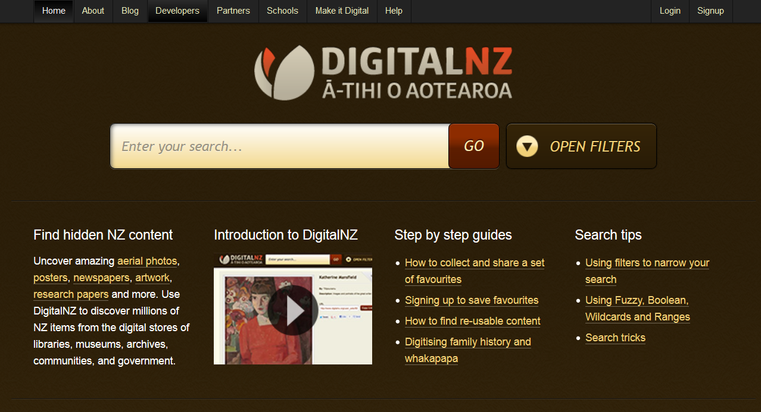
Example Web Service
www.digitalnz.org
Notes:
DigitalNZ is a big storehouse of digital NZ content – online images, articles, videos, etc.
They mostly gather up links that other institutions, e.g. Te Papa, have provided.
They put all the links in a giant searchable database and wrote a GET-based web front end for it.
It’s cool.

Slide 4
DigitalNZ Ā-tihi O Aotearoa
Base URL:
http://api.digitalnz.org/v3/records.xml
http://api.digitalnz.org/v3/records.json
http://api.digitalnz.org/v3/records.rss
Minimum query parameters:
text=yourSearchText
api_key=yourAPIKey
http://api.digitalnz.org/v3/records.rss?api_key=X8fThaDSTg4fG2SgbXzb&text=cat+dog
Notes:
DigitalNZ has three return formats, each with a different base URL.
XML and JSON we already know about.
The rss format is a particular XML dialect (the one people write rss feeds in).
When a web service provides rss format, it can be a good option for exploring the feed, because browsers will automatically render it pretty.
Of course, that makes it a bad choice for using from inside your app, because you don’t want it pretty.
We will look at both approaches today.
To search DigitalNZ, you need to supply at least two query parameters as key=value pairs: text and api_key.
(As always, the normal text is literal, and the italic text is what you replace with your own values.)
The search text is just what it sounds like – words you want to search for.
Go to the docs and you will see that there are operators for and & or, etc.
The api_key is a familiar thing with web services. All web services want to gather data about the patterns of use of their service. To ensure this, they require a unique identifier with every data fetch
Some services don’t require this if you’re coming in directly from a web browser’s address bar, but they all require it if you are coming in from code.
All the services will give you an API key for signing up. Just go ahead and do it. You don’t have to provide your real name if you don’t want to.
For our practical today, you can use my key, but there is no reason not to get one of your own.
Here is an example basic URL for accessing the DigitalNZ web service. We can see how it works by typing it directly into the address bar of a browser.
This searches for entries with “cat” and “dog” in the main search field (more on how to find out what that is in a minute) and returns the results in rss format.
You can see my API key there...
return "http://api.digitalnz.org/v3/records.json?api_key=X8fThaDSTg4fG2SgbXzb&text=aurora&per_page=5";
http://api.digitalnz.org/v3/records.rss?api_key=X8fThaDSTg4fG2SgbXzb&text=cat+dog

Slide 5
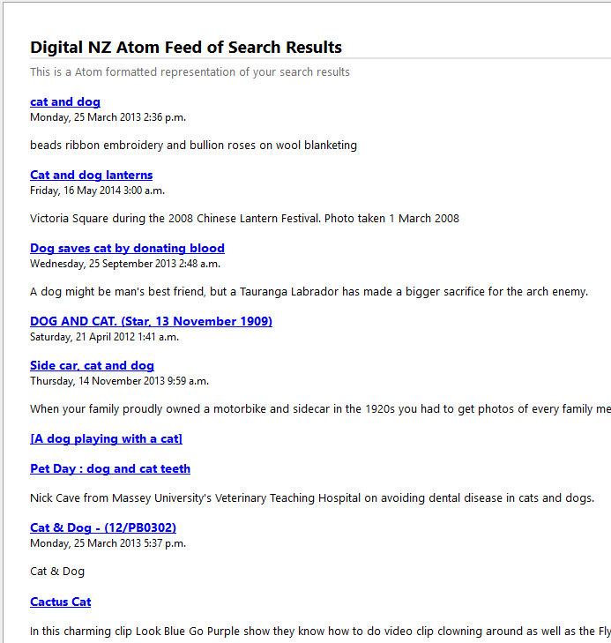
DigitalNZ Ā-tihi O Aotearoa
Notes:
We will look at the other formats in a moment...

Slide 6
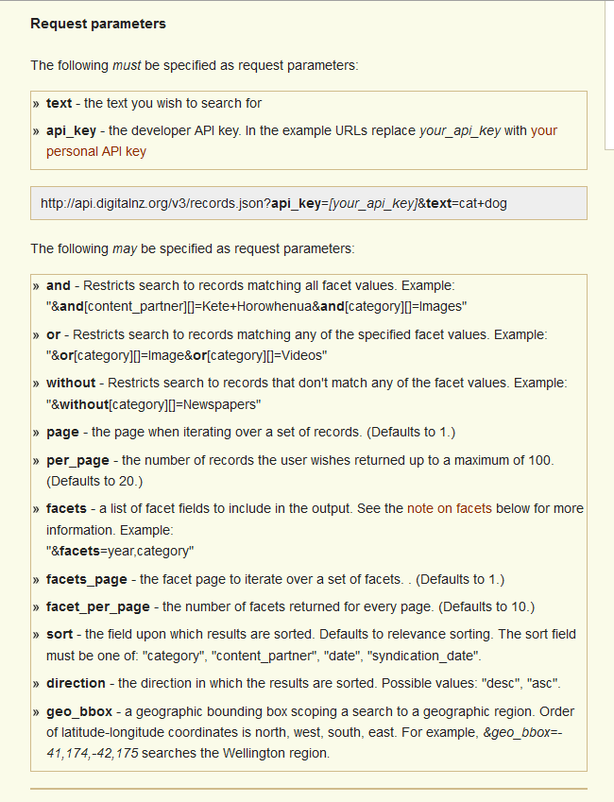
DigitalNZ Ā-tihi O Aotearoa
Notes:
To find out how to use any web API, you need to know what the keys are, what the permissible values are, etc.
For that, you need the documentation.
The documentation for DigitalNZ (click Developers on the home page) shows that there are lots of other possible query parameters.
Build the query string in the normal way &key=value for each parameter you wish to specify.
But we continue now with our minimal search query, and see how we can get it to run from inside our Android code.

Slide 7
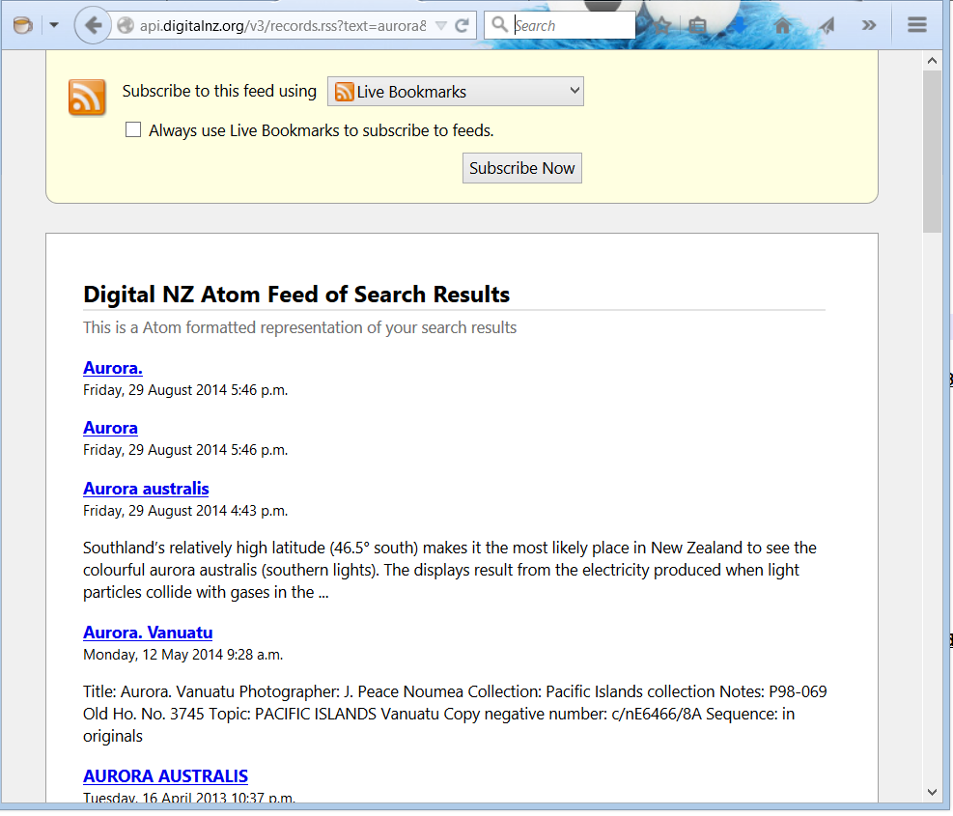
DigitalNZ Ā-tihi O Aotearoa
http://api.digitalnz.org/v3/records.rss?text=aurora&api_key=X8fThaDSTg4fG2SgbXzb
Notes:
Here is another query
I have asked for the data in rss format
I have searched for the keyword aurora
I have provided my api key
If I type this string directly in a browser window and hit return, I get this page. It scrolls on for as many results as were returned (that’s a query string parameter, by the way; the default is 20).
This is how RSS feeds are rendered by Firefox. Each of those links is clickable, and takes you to the original location of the archived item.
For example, this is that third one...

Slide 8
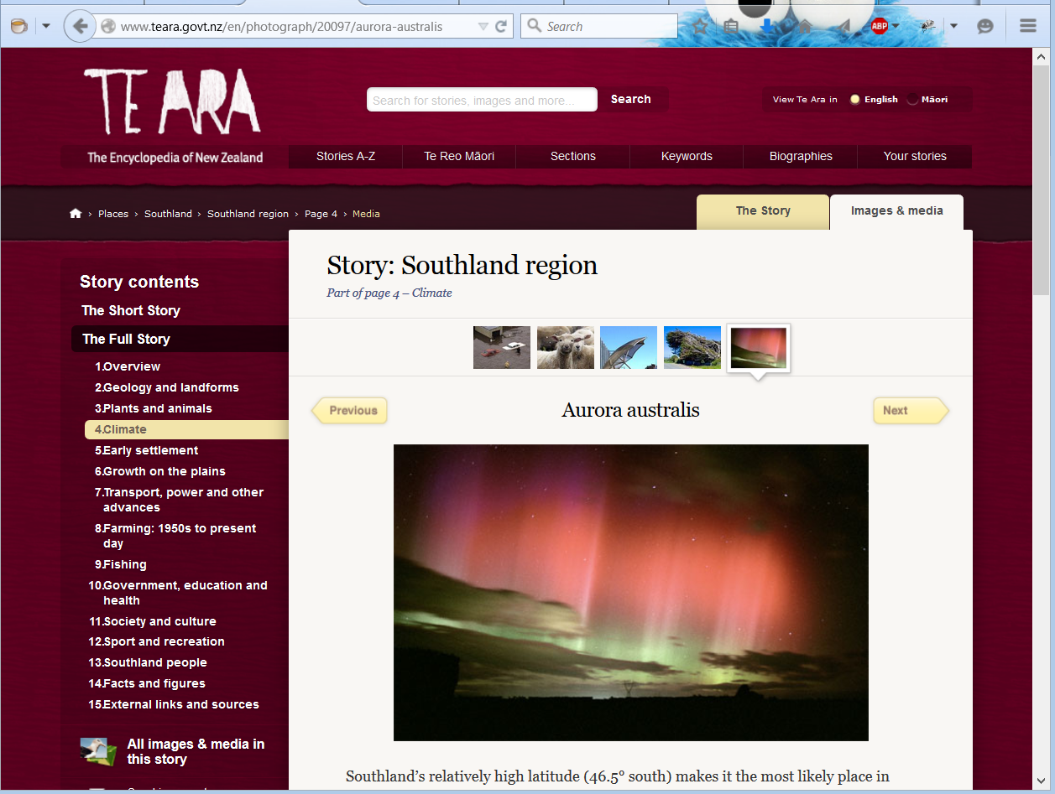
DigitalNZ Ā-tihi O Aotearoa
Notes:
We can generate the same query in xml format....

Slide 9
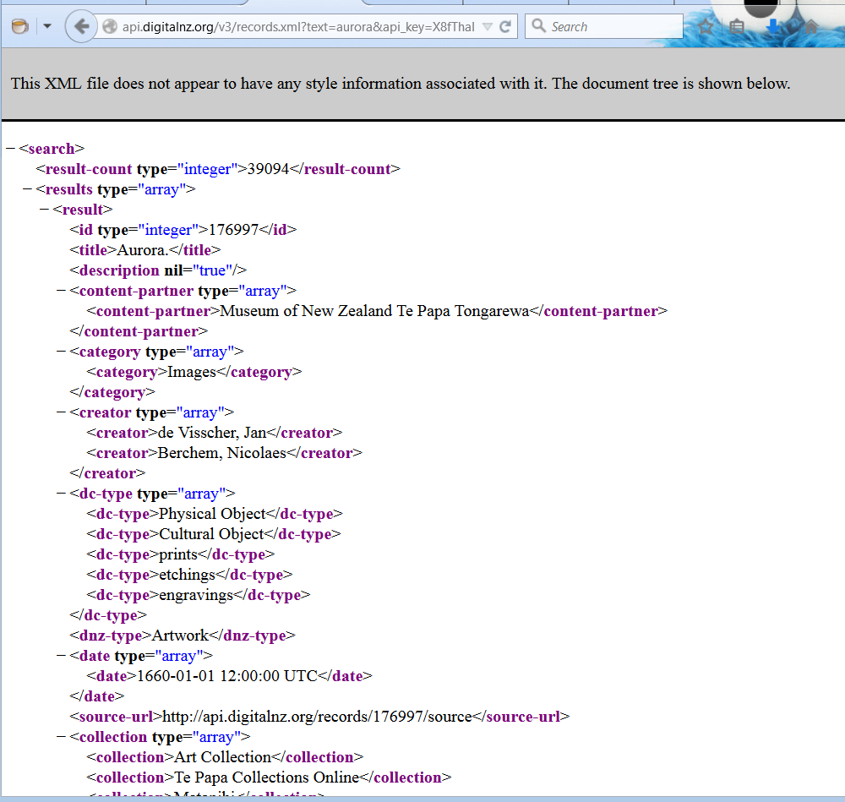
DigitalNZ Ā-tihi O Aotearoa
Notes:
Here is the same query in XML format...
Note the url
Again, the browser is rendering for you. The underlying source is raw XML.

Slide 10
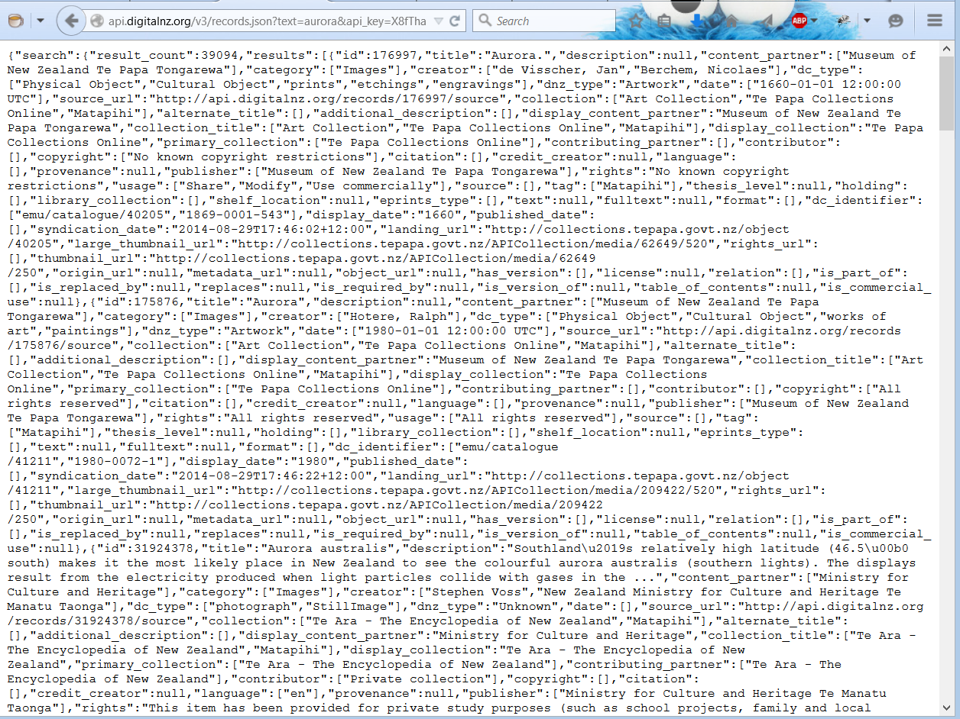
DigitalNZ Ā-tihi O Aotearoa
Notes:
And here is the JSON
Note the URL
The browser doesn’t pretty up the JSON.
It gets the text and dumps it to the screen.
This is what we are going to work with from inside our app.
As we saw last time, it can be difficult to work out the JSON schema when text is displayed like this, so we can pop this into a viewer...

Slide 11
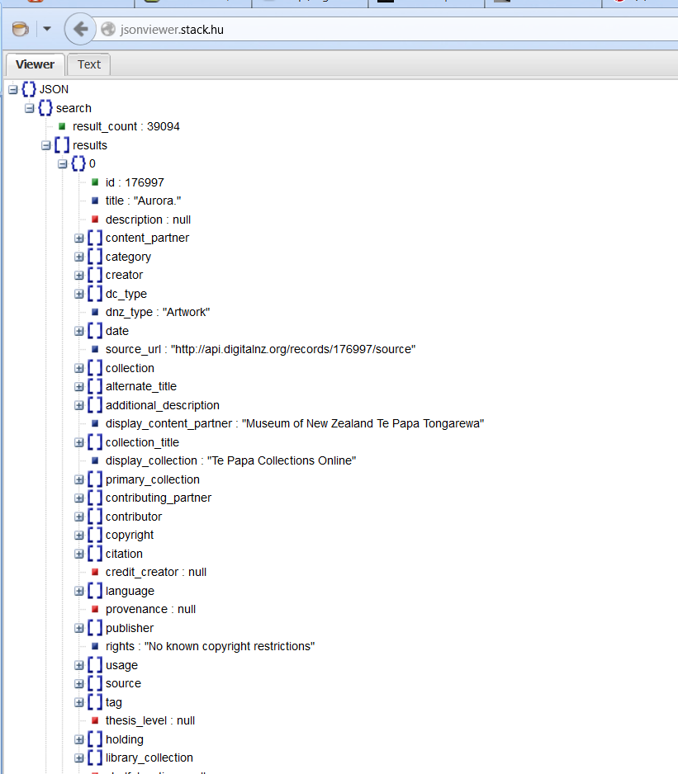
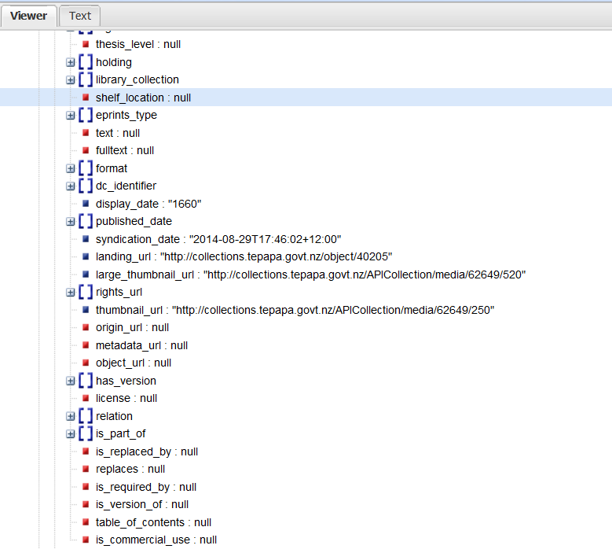
DigitalNZ Ā-tihi O Aotearoa
Notes:
Over two columns here
There is a root element.
It has a field with key “search” whose value is an object
That object has a field with key “result_count” whose value is a string. It tells us there are 39094 records containing the keyword Aurora
The search object also has a field with key “results” whose value is an array of object
Each of those objects has a zillion key:value pairs in it, including scalars “title”, “description”, “source_url”, “landing_url” and a bunch of arrays of strings, like citation, collection, creator, and so on.
Heaps of data, and because we know how to parse JSON with Android, if we can just get that JSON string into our app, we can use the data.

Slide 12

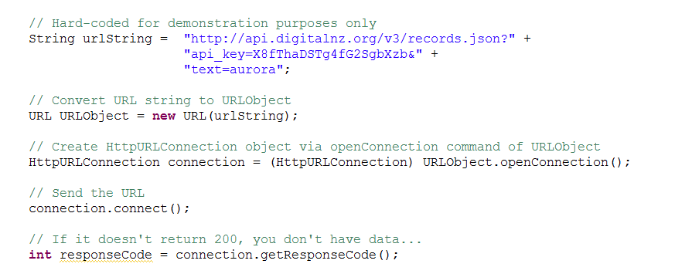
Basic Android HTTP
Notes:
Modern programming platforms that want to talk to the internet will supply classes and libraries that handle the low level networking stuff.
The developer’s job is to build the URL as a string, pass it to the correct class and deal with whatever is returned.
C# has classes for this; JavaScript has classes for this. And Java has classes for this. Android uses Java’s classes.
These are the libraries.
We will look at the basic commands.
NB: All try catch removed for clarity. You will have to put it back in; it is required.
Be aware though, that to get this working in Android there is a more-than-slight complication.
We’ll get to that in a minute.
(Walk through code.)
What other response codes might you get? => 404, it wasn’t there. 401, you don’t have permission, etc.
Assuming you get 200, you’ve got data on the connection object, and you read it in with a streamreader....

Slide 13
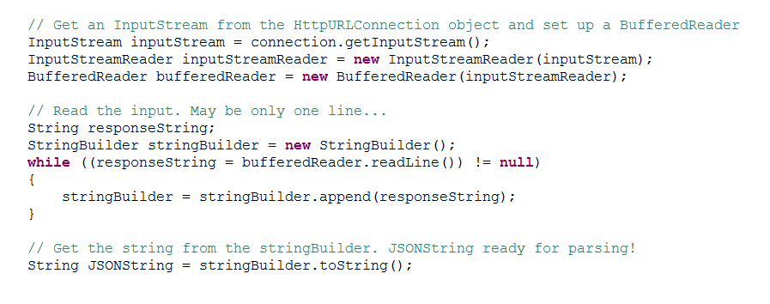
Basic Android HTTP
Notes:
Handout full method with try-catch
So that’s all that’s involved:
Figure out the query parameters
Build the URL as a string
Use the Java classes to make the call, producing an input stream
Pull out the data as a string
Parse it with JSONObject and JSONArray.
Except there is just one little problem....

Slide 14
One Little Problem
In current versions of Android, HttpURLConnection calls must be made asynchronously (i.e. on their own processing thread).
Notes:
That’s right: it’s multi-threading time!
Presumably many of you have never done multi-threading, and presumably you have always heard that it is really hard.
This is true.
There are all kinds of problems with safety and communication and so on. For example, if you’re in a separate thread, you can’t talk to the Activitiy’s controls, so how can you put things into ListView?
Luckily, those clever Android developers have wrapped up the whole multi-threading thing for you in a nice class that makes it very easy.
Let’s take a look.

Slide 15
AsyncTask<T,T,T>
A class that makes multi-threading easy(ish).
Method | Where it’s executed | What it’s for
onPreExecute | Main thread | Set up
doInBackground | Separate thread | Http call. Can return whatever type you want
onPostExecute(T) | Main thread | Using the fetched data Accepts the output of doInBackground
Notes:
A template class that takes 3 types.
We will see what they are in a minute
It has these three methods, that we are going to use.
There is a 4th method for updating progress while the async is running, but we’re not going to use it.
In fact, we’re not going to use onPreExecute either today. Those are left as an exercise.
We will concentrate on doInBackground and onPostExecute

Slide 16
AsyncTask<T,T,T>
Process:
Declare an inner class that extends AsyncTask<>
Put the Http call code in the doInBackground method
Put the Activity code for using the returned data in the onPostExecute method
Match up all the arguments and return types (more detail on this in a minute)
Create an instance of your class.
Call its .execute() method
Notes:
When you call the .execute() onPreExecute runs (if you’ve put any code in there)
Then doInBackground runs in its own thread, as required. Android handles all the details of this multi-threading, so you don’t have to.
Whatever it returns is given to onPostExecute, which runs in the Activity’s main thread, so it can see the controls.
Let’s look at the “match the types” part more closely, then we’ll see some examples.

Slide 17
AsyncTask<T,T,T>
The three types you declare are:
What is passed into onPreExecute
What is sent to onProgressUpdate
What is returned from doInBackground and passed to onPostExecute
If you don’t need to specify a type, use Void (note the capital V)
Notes:
In the first instance, we aren’t using either onPreExecute or onProgressUpdate, so we will always specify Void for the first two.

Slide 18
AsyncTask<T,T,T>
Notes:
Here’s an example of the function headers
The inner class Async descendent. These args mean:
I am going to return a String from doInBackground.
The output of doInBackground becomes the input argument to onPostExecute.
So onPostExecute is going to accept a string
I don’t care about the other two, so leave them as Void
From this, we can work out what the methods signatures of doInBackground and onPostExecute are.
doInBackground returns a string.
(Those input args are for if we were using onProgressUpdate. We’re not, so we want to make them Void. This is the syntax for that. It’s a Java thing.)
And onPostExecute. It accepts whatever doInBackground returns.
Say we want to make our call to DigitalNZ and drop the returned JSON into a textview on the MainActivity:
Where does the HttpURLConnection, responseCode, inputStream stuff go? => in doInBackground
Where does the findViewById, setText stuff go? => onPostExecute.
Where does the “make an instance and call its .execute() method stuff go? In the Activity, wherever we want. In my demo, its in a button click handler.
Let’s look at the code...

Slide 19
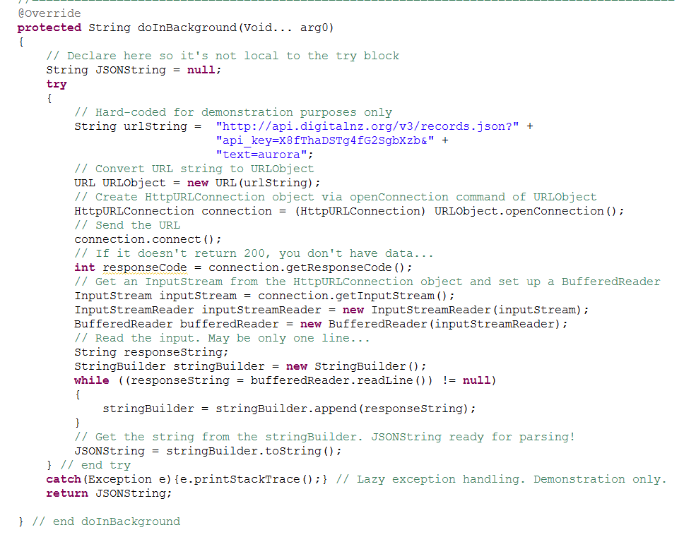
class AsyncAPIShowRawJSON extends AsyncTask<Void,Void,String>
Notes:
Here is doInBackground.
This is EXACTLY the code in the handout, with the white space removed to make it all fit on one slide.
In fact, you should have made that code into a method, and all you would see here is the method call and the return of the string the method returns.
It makes the call, pulls the text off the connection object, coerces it into a string and returns it.

Slide 20
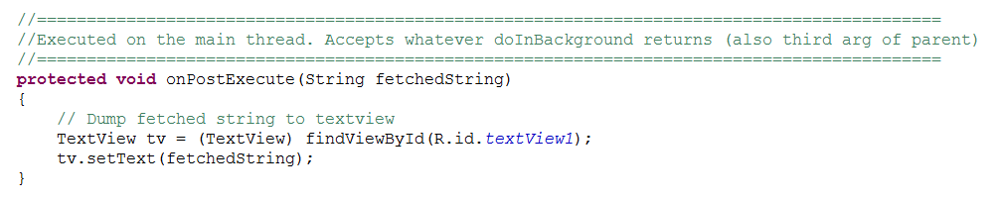
class AsyncAPIShowRawJSON extends AsyncTask<Void,Void,String>
onPostExecute is declared in the AsyncTask child class, but executes on the Activity’s thread.
Notes:
Here is onPostExecute
Nothing exciting here. Take in a string, dump it into a textview.
Of course you could do lots of exciting things here. Like parse the JSON and pull out all the resource titles, or links or creators, or whatever, and put them in a ListView.
We can wire up the button in the onCreate.

Slide 21
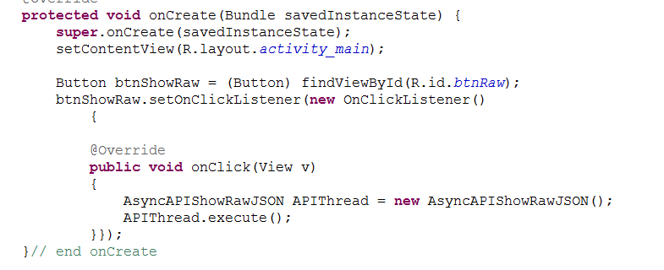
class MainActivity extends Activity
Notes:
Back in the MainActivity class, we wire up the button to make and execute an instance of our AsyncTask child.
I’ve done this inline to save space for the slide, but still recommend declaring an inner class for the OnClickListener.
Here’s how the app looks...

Slide 22
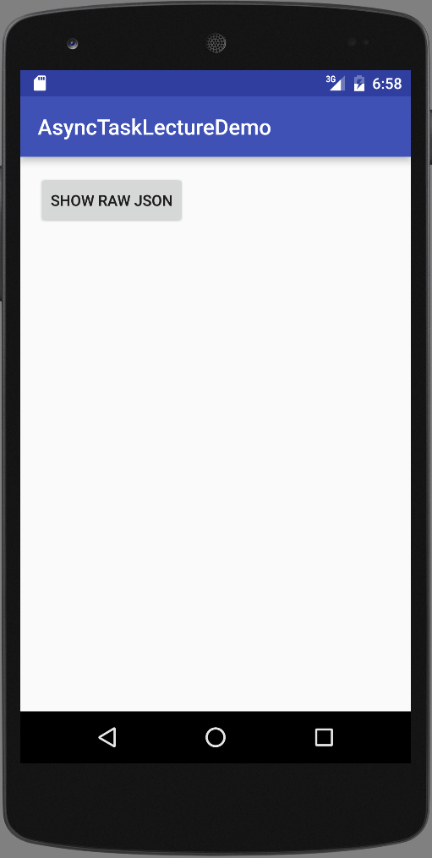
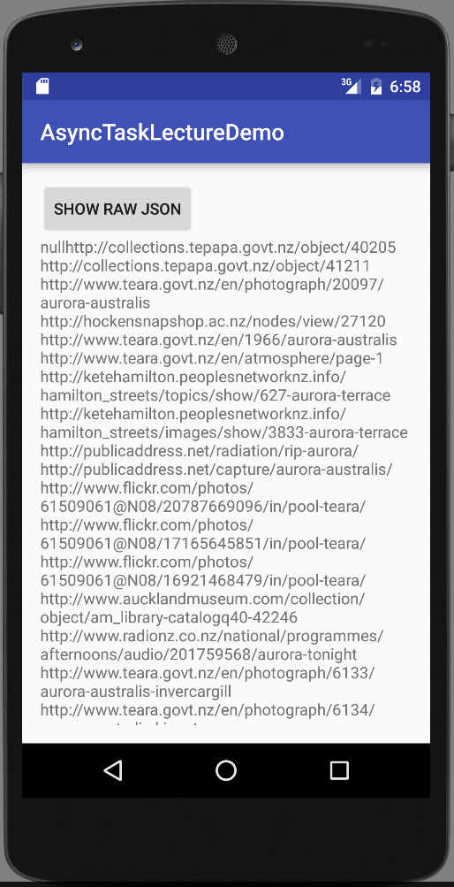
Example
Notes:
Before and after the button click

Slide 23
Using a Web Service
Find a service that provides data that you want.
Figure out its query parameters (API)
Define an AsyncTask descendant
Make the Http call in doInBackground
Use the returned data in onPostExecute
Match up the return types and arguments both in the method headers and in the AsyncTask<T,T,T>
Make an instance of your class and call its .execute() method.
Notes:
Let’s just review the process
Figure out the query parameters
Build the URL as a string
Use the Java classes to make the call, producing an input stream
Pull out the data as a string
Parse it with JSONObject and JSONArray.

Slide 24
Technical Note
Must add to AndroidManifest.xml:
<uses-permission android:name="android.permission.INTERNET">
</uses-permission>
This goes outside the <application> element but inside the <manifest> element.
NB: The modern permissions model actually requires more than this in some situations. We will deal with that later.
If your app complains about permissions, make sure your minSdkVersion is 18 or lower (change in build.gradle (Module.app))
Notes:
Android is good about specifying what permissions each app needs.
Apps that need to access the internet have to make this explicit by adding the line above to AndroidManifest.xml.
(Can also use a self-closing tag here.)
This goes OUTSIDE the <application> element.
On installation, the user can be queried about these kinds of permissions.
NB: The modern permissions model actually requires more than this in some situations. We will deal with that later.
If you get growled at about permissions, make sure your minSdkVersion is 18 or lower (change in build.gradle (Module.app))

